Slide 1
School Health Advisory Councils
Missouri Department of Health and Senior Services

Slide 2
If schools do not deal with children’s health by design, they deal with it by default.
Health is Academic, 1997

Slide 3
Objectives
Understand the Whole School, Whole Community, Whole Child approach to school health
Understand the role and function of School Health Advisory Councils
Discuss criteria for council membership and successful recruitment of community partners
Develop 3 action steps to get started in developing your school’s School Health Advisory Council

Slide 4
Whole School, Whole Community, Whole Child (WSCC) Model
Effective school health programs go beyond the classroom
The WSCC Model expands on the Coordinated School Health approach
WSCC includes 10 components
Health Education
Nutrition Environment and Services
Employee Wellness
Social and Emotional School Climate
Physical Environment
Health Services
Counseling, Psychological and Social Services
Community Involvement
Family Engagement
Physical Education and Physical Activity
Notes:
As our quote said earlier, schools will deal with children’s health by design or default, but effective school health programs go beyond just the classroom.
The Whole School, Whole Community, Whole Child (WSCC) model expands on the eight elements of CDC’s coordinated school health approach and is combined with the whole child framework. CDC and ASCD developed this expanded model—in collaboration with key leaders from the fields of health, public health, education, and school health—to strengthen a unified and collaborative approach designed to improve learning and health in our nation’s schools.
The 10 components of WSCC are:
Health Education
Nutrition Environment and Services
Employee Wellness
Social and Emotional School Climate
Physical Environment
Health Services
Counseling, Psychological and Social Services
Community Involvement
Family Engagement
Physical education and Physical Activity

Slide 5
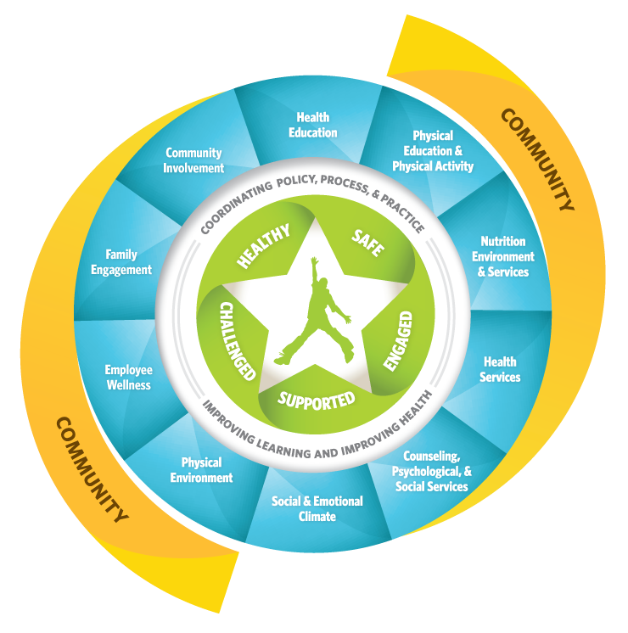
Whole School, Whole Community, Whole Child (WSCC) Model
Notes:
The child in the center is at the focal point of the model; the child is encircled by the “Whole child” tenets in green, being healthy, safe, engaged, supported and challenged.
The white band emphasizes the alignment, integration and collaboration needed among the school, health, and community sectors to improve each child's learning and health.
Represented in the blue, the multiple school components surround the child, acting as the hub that provides the full range of learning and health support systems to each child, in each school, in each community.
The community, represented in yellow, demonstrates that while the school may be a hub, it remains a focal reflection of its community and requires community input, resources, and collaboration in order to support its students.

Slide 6
How?
School Health Advisory Councils (SHACs)
Notes:
How do we get this collaboration and community input into the health of our students? Through School Health Advisory Councils or SHACs.

Slide 7
What are School Health Advisory Councils (SHACs)
Advisory group composed primarily of individuals selected from segments of the community and school
The group acts collectively in providing guidance and leadership to the school system on all aspects of the school health program
Notes:
A School Health Advisory Council is a core group of parents, youth, educators and others who represent different segments of the community. The key purpose of the SHAC is “advising”. The group works together to give advice and support to the school on all parts of its school health program. The council is not part of the school’s administrative structure, nor does it hold any legal responsibilities. The kind of advice given depends upon the role the school wants it to serve.
Because of this, no two councils are exactly alike.

Slide 8
Why Have a SHAC?
Schools can’t do it alone
Research endorses community connections and involvement for children and youth
Changing systems requires infrastructure to support that change over time
Notes:
A coordinated school health program is designed to help young people grow into healthy and productive adults by focusing on their physical, emotional, social and educational development. Schools can’t do it alone. An effective school health program is a working partnership between schools and the community, including parents and youth. Primarily, it recognizes that health and academic success go hand in hand.
By creating a SHAC, schools can find partners within their communities to identify health problems and concerns, set priorities and design solutions. When engaged as decision makers, communities have proven time and again that they are up to the task of addressing local problems and supporting their schools in their responsibilities.
Research suggests that one of the most effective vehicles for interacting with the local community on school health issues is through a SHAC. There are many ways that staff and schools at the local level can help ensure that they SHAC provides a community voice in planning and implementing comprehensive school health programs.

Slide 9
Benefits of a SHAC
Increase parent and community involvement
Link schools with community health and social services and resources
Educate the community about the school and health issues
Increase effectiveness and sustainability of school-community initiatives

Slide 10
Role of a SHAC
Program planning
Advocacy
Fiscal planning
Liaison with district and state agencies
Direct intervention
Evaluation, accountability and quality control
Notes:
A SHAC has a variety of roles depending on how the school system chooses to use it. Some common roles that are assigned to SHACs include, but aren’t limited to are
Program Planning – Ensuring that professionals who directly influence student health get access and education around teaching strategies, best practices, curriculum development, discussion of health issues, and other professional development.
Advocacy – SHACs provide visibility for school health within the district and community. They can ensure appropriate resources, intervene with unfavorable decisions, engage the community on behalf of school health and provide linkages to resources.
Fiscal Planning – SHACs can assist in determining how much funding is required to conduct a quality school health program, including raising funds and grant writing.
Liaison with other agencies – SHACs can work with agency personnel in curriculum development, food service programs, distribution of funding, and policy making.
Direct Intervention – SHACs can suggest, support and advocate for policies related to smoking, alcohol use, and sale of nutritious foods as well as organizing health fairs and health promotion activities.
Evaluation, Accountability and Quality Control – SHACs can ensure funds are spent appropriately, ensure healthy food and activities are used, and conduct focus groups and assessments of school policies and environment.

Slide 11
Developing a Council
There may be existing councils that could function as a SHAC
If not:
Review any established school district procedures for advisory councils
Prepare a brief proposal on the formation of a SHAC
Gain support of the school district
Hold an initial meeting to determine interest in serving on a SHAC
Notes:
So, how do you start a council?
Rather than creating a new council, there may be an existing council that could be expanded to become a SHAC. For instance, a Safe and Drug-Free School committee or a Worksite Wellness committee could be expanded to address all areas of a coordinated school health program.
If there is not an existing council or committee at the district some first steps to developing an advisory council include:
Review any established school district procedures from advisory councils,
Prepare a brief proposal on the formation of a SHAC,
Gain support of the school district, and
Hold an initial meeting to determine interest in serving on a SHAC.

Slide 12
SHAC Membership
Pair and Share
What types of people would make good council members?
Brainstorm a list of at least 5 criteria for selection.
Notes:
Lets take about 5 minutes, and with a partner or at your table, come up with a short list of types of people that would make good members as well as criteria you would use for selection. Then we will compare your lists with suggested members and representatives.

Slide 13
SHAC Membership
Membership should include:
Representatives with awareness of all segments of your community
Those with a passion and interest in youth
Those with professional ability
People with a willingness and ability to commit time
Both those key players and influences as well as the least powerful
Notes:
School Health Council membership should be as representative of the school and community as possible, including those with a variety of backgrounds and experience including various genders, races/ethnicities, ages, education background and economic levels.
Include those who already demonstrate an interest in youth, such as those involved in PTA, scouts, civic groups, etc. These individuals already often have an understanding of the needs of youth, as well as a passion to serve them.
Those who have professional training in a youth related discipline are obvious potential members, although training and agency affiliation does not ensure the value of an individual to SHAC activities.
A council will be more successful if all members are active and engaged.
And although key leaders in the community and school are important, it is just as important to include those you may not typically think of these type of leadership and volunteer activities.
Most importantly, your council will be stronger if all members genuinely hold student health and success as their driving priority.

Slide 14
Suggested Members
Administrators
Parents
Students
Medical professionals
Attorneys
Law enforcement officials
Government officials
Recreation professionals
And other interested citizens
Other representatives include:
Social services agencies
Business/industry volunteer
Public health agencies
Churches/synagogues
Hospitals/clinics
Service organizations
Colleges/universities
School youth groups
Professional societies
Notes:
Suggested members include
Administrators
Parents
Students
Medical professionals
Attorneys
Law Enforcement officials
Government officials
Recreation professionals
And other interested citizens
Other representatives may include
Social Services agencies
Business/Industry Volunteer
Public Health Agencies
Churches/Synagogues Hospitals/Clinics
Service Organizations
Colleges/Universities
School Youth Groups
Professional societies
Thinking back to the exercise we just completed, did you come up with similar types and criteria as is listed on the past two slides?
Any suggestions that stood out to you?
Were there any you had included that you feel were missed in these suggestions?
Remember that each SHAC and each community is different, so there may be people and agencies that are involved in one SHAC that you may not be able to include in yours.

Slide 15
Recruitment
Before
Be able to articulate your purpose
Draft SHAC roles and responsibilities
Have a meeting structure in mind
During
Put yourself in their shoes
Help them understand what they can contribute and how they can benefit
Be sensitive to constraints on their time and resources
Notes:
Recruitment can be difficult, but with the brainstorming we’ve already done, and the tools you will be offered at the end of the powerpoint, you have a great start toward building an effective School Health Advisory Council.

Slide 16
Youth as Partners
To have successful youth participation:
Discuss stereotypes
Share power and responsibility
Clearly define roles and responsibilities
Ensure youth decision making
Consider logistical needs
Notes:
SHACs are formed with the goal of improving the health of schools for the benefit of everyone, including its students. One flaw in many SHACs is that the adults running them do not think to include youth as part of the membership.
Some keys to having successful youth participation include:
Openly discuss stereotypes that youth may have about adults, and that adults may have about youth
Practice shared power and responsibility for activities
Establish clearly defined roles and responsibilities for adults and youth
Establish clear decision making processes that ensure youth are included in meaningful ways
Pay careful attention to logistical issues that may affect youth participation

Slide 17
Youth Involvement
Youth can be involved by:
Prioritizing needs
Developing strategies/program activities
Promoting program/activities to other youth
Providing TA on youth culture
Participating in research
Presenting results
Notes:
There are many ways that youth can be involved and helpful throughout the SHAC process
Youth can help to prioritize needs. They have a large network of friends and family who access local resources.
Youth can help create activities and programs that will be of particular interest to their peers.
Having young people take the lead in creation and promotion of programs and policies is a great way to get youth involved. Recruitment is strengthened when their peers know that these opportunities were developed based on youth interests.
Youth can train interested adults in youth culture. Sharing information on technology, social media, and general interests.
Young people make excellent data collectors. They can take surveys and conduct interviews while developing skills that will help them in the future.
And finally, youth can help present results. If they’ve had a role throughout all levels of a program, most are more than willing to share the results of their hard work. Giving them this opportunity will resonate with the audience and can have an important impact on the youth’s self efficacy.

Slide 18
Youth Involvement
Examples of Current Youth Advisors in MO
Foster Care Youth Advisory Councils
Teen Advocates for Sexual Health (TASH)
Adolescent Health Youth Advisors
Others?
Do you currently have youth involvement?

Slide 19
What’s Your Pitch?
Based on the information we just discussed, create a 30 second “pitch” your team could use to invite key individuals to be part of your SHAC.

Slide 20
Now What?
Operating Guidelines/By-Laws
Strategic Planning
Mission
Goals
Objectives
Notes:
Once you have your membership set up, now what does the SHAC do?
The first step would be to set up some operating guidelines or by-laws for the council to follow. These would include decisions and guidance about the
Name and purpose of the SHAC
Membership
Meetings
Officers
Voting
Committees
Communications
Amendments
Another common activity used to guide SHAC work, is the development of a strategic plan. The plan should be developed for a specific amount of time, a school year, or a 3-year period. A mission would be developed; the ideal outcome of the SHAC’s work. Then the goals, what the SHAC must achieve to reach that Mission. And finally, the objectives, the specific actions that are required to achieve those goals. It is important that they are measureable and obvious when complete.

Slide 21
Assessment
School Health Index (SHI)
Identify strengths and weaknesses of health and safety polices and programs
Develop an action plan for improving student health
Engage teachers, parents, students and the community in promoting health enhancing behaviors and better health
Notes:
The type of assessment that is common for SHACs, is a whole school health assessment. This type of assessment looks at not only the education aspects, but nutrition, environment and other services. The suggested tool for such an assessment is the School Health Index, or SHI.
The School Health Index was developed by CDC in partnership with school administrators and staff, school health experts, parents and national agencies. The SHI was developed to help schools
Identify strengths and weaknesses of health and safety polices and programs.
Develop an action plan for improving student health.
Engage teachers, parents, students and the community in promoting health enhancing behaviors and better health.
The newest version of the SHI was released in 2017 after being updated to incorporate the WSCC model, including adding modules on the Social and Emotional Climate and Physical Environment.
Although the SHI itself is a free resource available from the CDC, it is a very involved process and many schools bring in a trained SHI facilitator to assist with this process. Trained facilitators may be found at the state health and education agencies as well as agencies tasked with professional development of local education agencies.

Slide 22
Assessment
Health Program Assessment
Health Education Curriculum Analysis Tool (HECAT)
National Sexuality Education Standards (NSES)
Notes:
Second would be an assessment of the health education programming. This would look in depth at the education that students are receiving on health topics in kindergarten through high school. One such tool is the Health Education Curriculum Analysis Tool, or HECAT. The HECAT is available from CDC and can be customized to meet local needs and school specific standards.
Using the HECAT can
Help ensure a complete, thorough, and consistent review of a health education curriculum
Help clarify what should be included in a health education curriculum
Help ensure that the curriculum is aligned with research-based practices, the National Health Education Standards, and CDC's Characteristics of an Effective Health Education Curriculum
Help identify instructional strategies that improve teaching and student learning
Inform your selection of a high-quality curriculum that is affordable and feasible to implement in your schools
Provide sound and defensible justification for curriculum decisions to parents, school board members, and others interested in health education in your community or state
Also available is a tool for assessing sexual health education programs. FOSE, or the Future of Sex Ed, worked with a number of national organizations and agencies to develop the National Sexuality Education Standards or the NSES. These standards were developed to address the inconsistency in sexual health education programs across the US. The standards give research based minimum requirements for youth, grades K-12, that is evidence-informed, age appropriate and theory driven.

Slide 23
What We’ve Learned
Factors that help a SHAC work:
Active support from school administration
Carefully plan member selection
Involve the entire school and community, especially youth
Set clear goals and objectives for your SHAC
Assess and improve your school

Slide 24
Next Steps
What else do you need to know to support a school health advisory council?
Develop a list of potential SHAC members and identify how they can benefit from being involved.
Set 3 action steps you can accomplish in the next month to start up or revive your school’s SHAC.

Slide 25
Resources
SHAC Guide from MCSHC
http://www.healthykidsmo.org/resources/docs/SHAC/SHAC_Guide.pdf
School Health Index
https://www.cdc.gov/healthyschools/shi/index.htm
HECAT
https://www.cdc.gov/healthyyouth/hecat/
NSES
https://www.advocatesforyouth.org/resources/health-information/future-of-sex-education-national-sexuality-education-standards/

Slide 26
Questions and Contacts
Questions?
Missouri Department of Health and Senior Services
Bureau of Community Health and Wellness
School Health and Adolescent Health Program
shs@health.mo.gov
Adapted from Oregon Dept. Of Education

